Slide 1

PROJECT : INDIAN FOOD
NAME : AAKASH KUMAR
BRANCH : DATA SCIENCE
ROLL NO. : 23DS001

Slide 2
INTERDUCTION
Indian food data analytics is about studying Indian recipes and eating habits to find out what’s popular and why people like certain dishes. It helps us understand the food culture in India better

Slide 3
SQL SERVER
Data Storage: SQL Server can store large volumes of data, including detailed information about Indian dishes, ingredients, nutritional values, and region, state.
Data Cleaning: It provides functions to clean and preprocess data, such as removing duplicates, handling missing values, and correcting errors, ensuring the data is accurate for analysis.

Slide 4
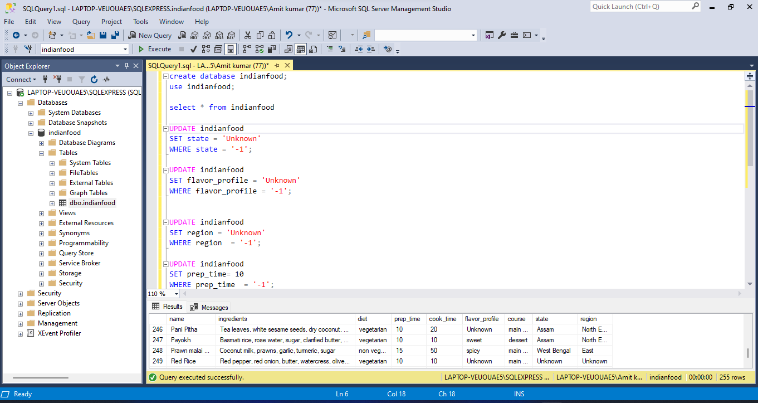
Step 1- DATA CLEANING BY SQL SERVER

Slide 5
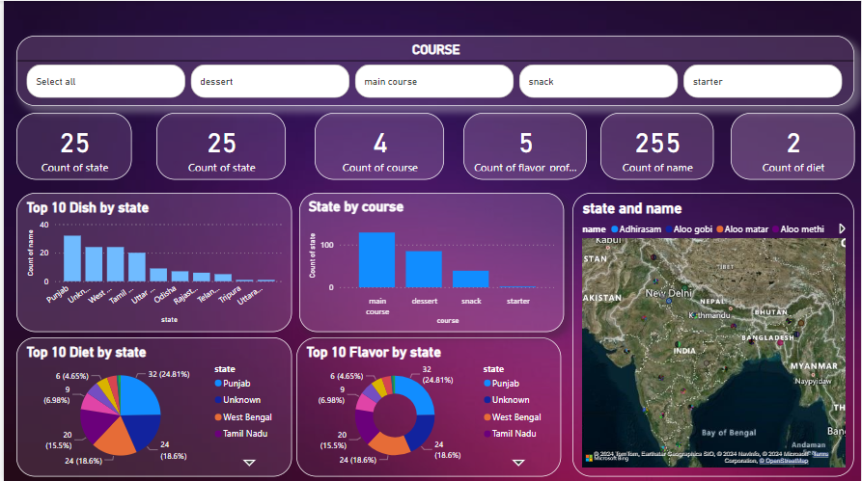
STEP 2-CREATE A DASHBOARD BY POWER BI

Slide 6
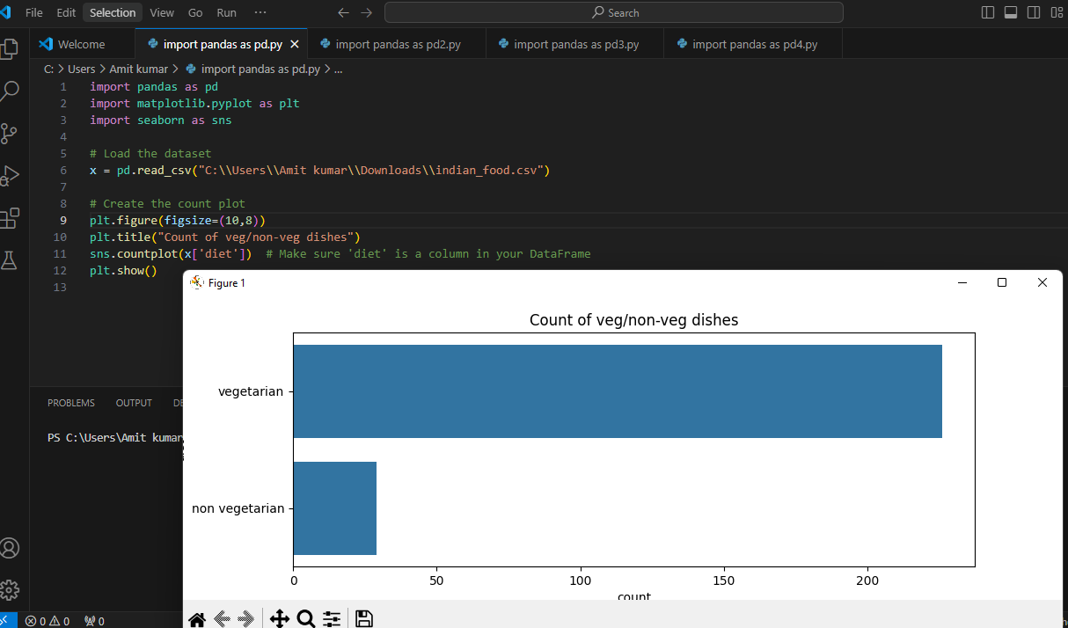
STEP 3- CREATE GRAPH BY PYTHON

Slide 7
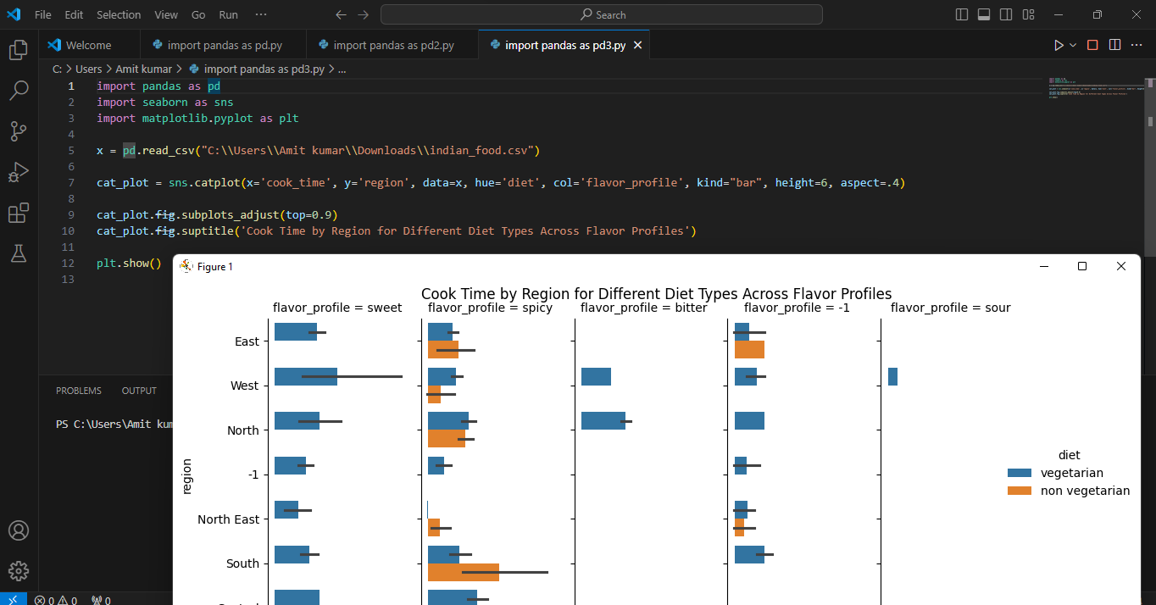

Slide 8


